Slide 1

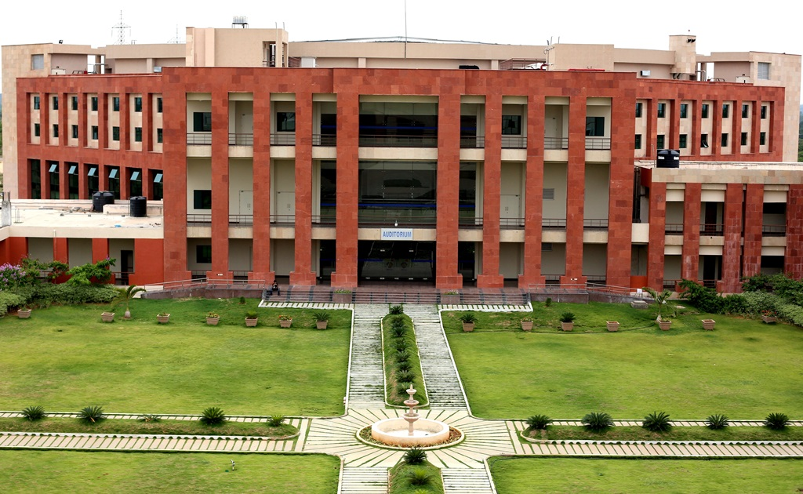
Principles of Programming Languages
(CS F301)
Jabez Christopher
Assistant Professor
Department of CSIS

Slide 2
Language Evaluation Criteria
 |  | CRITERIA
 |  | READABILITY | WRITABILITY | RELIABILITY
CONTRIBUTING CHARACTERISTICS | Simplicity | ✓ | ✓ | ✓
 | Orthogonality | ✓ | ✓ | ✓
 | Data types | ✓ | ✓ | ✓
 | Syntax design | ✓ | ✓ | ✓
 | Support for abstraction |  | ✓ | ✓
 | Expressivity |  | ✓ | ✓
 | Type checking |  |  | ✓
 | Exception handling |  |  | ✓
 | Restricted aliasing |  |  | ✓

Slide 3
PL Design - Computer Architecture
The Von Neumann Architecture has the following components:
Central Processing Unit (CPU)
ALU
Control Unit
Registers
Clock
Immediate Access Store (IAS)
Input / Output (I/O)
-----------------------------------------------------------------------------
Utilises a single processor
Utilises one memory for both instructions and data
Implements programs by executing one instruction at a time

Slide 4

PL Design - Computer Architecture
The Von Neumann Architecture has the following components:
Central Processing Unit (CPU)
Immediate Access Store (IAS)
Input / Output (I/O)
---------------------------------------------------------------
Utilises a single processor
Utilises one memory for both instructions and data
Implements programs by executing one instruction at a time
https://www.youtube.com/watch?v=bYTMitis-v4&t=12

Slide 5
PL Design - Methodologies
• Top Down Design — Procedure Oriented
• Object Oriented Design — Data Oriented

Slide 6
Language Categories
 |  | Functional approach | Object-oriented programming
CHARACTERISTICS | Definition | emphasizes on evaluation of functions | based on a concept of objects.
 | Data | uses immutable data. | uses mutable data.
 | Execution | does follow a declarative programming model. | the statements should be executed in a particular order.
 | Iteration | the statements can be executed in any order. | loops are used for iterative data
 | Element | The basic elements of functional programming are Variables and Functions. | The basic elements of object-oriented programming are objects and methods.
 | Use | Functional programming is used only when there are few things with more operations | Object-oriented programming is used when there are many things with few operations.

Slide 7

PL - CATEGORIES
• Imperative — C, C++
• Functional — Scheme, ML
• Logic — ProLog.
• Object Oriented Design — Simula, Small Talk
• Visual Languages — .NET Languages, C#
• Markup Languages — HTML, XML
https://www.youtube.com/watch?v=563k1fsFB7A

Slide 8
Language Categories
Visual languages
Include capabilities for drag-and-drop generation of code segments
Scripting languages
Perl, JavaScript, and Ruby, are imperative languages
Logic programming language
Rule-based languages – Prolog, LISP
Special-purpose languages: Emulators, systems simulations ect

Slide 9
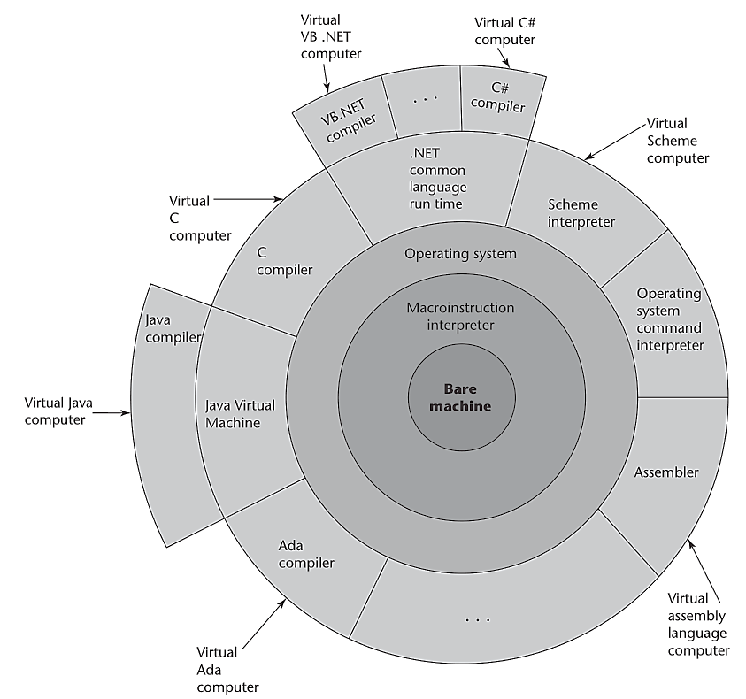
Language Implementation Methods

Slide 10
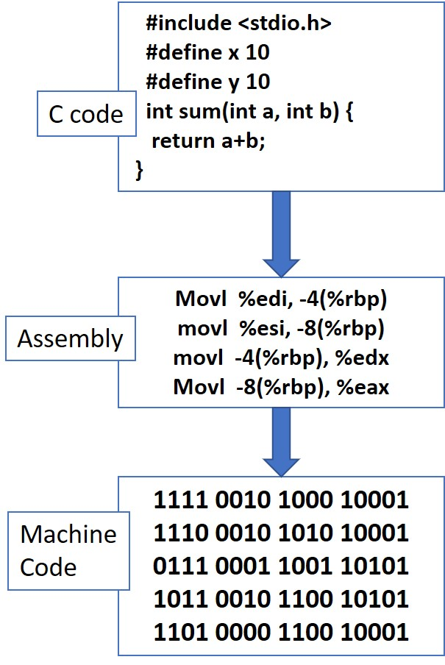
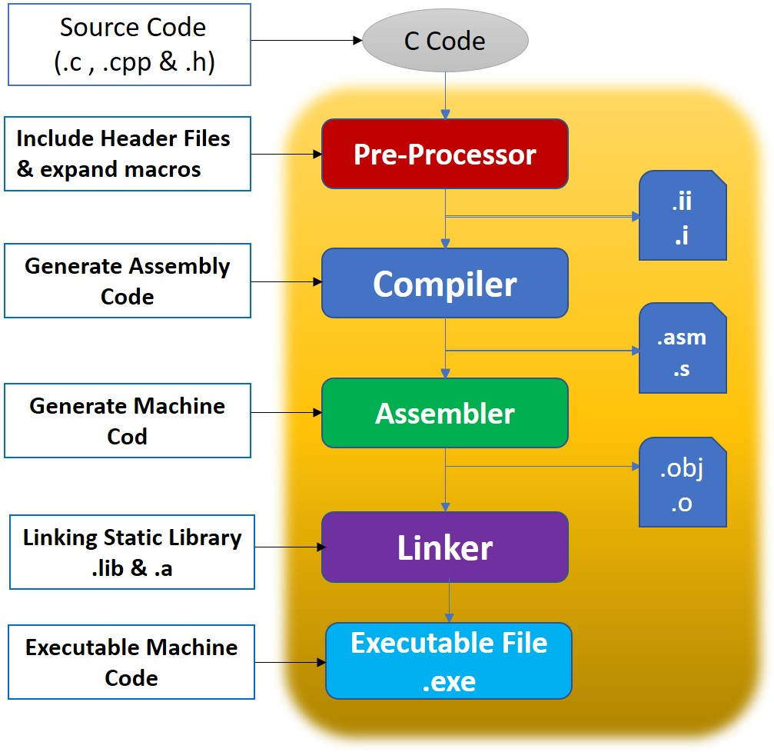
Language Implementation Methods

